Slide 1
Use of Portfolio Analysis in Data-driven Decision Making
Thomas Houze, Ph.D., M.Sc.
NIAID/DAIDS/PMPRB
National Institutes of Health

Slide 2
Table of Contents
NIAID Data Grant from 1977-2022
FOA Data
Study Section Data
Activity Code Data
Projects ending in 2024 Data
Examples of Animated of Data
Histogram
Bubble Plot
Notes:
This is the “Table of Contents” for this presentation

Slide 3
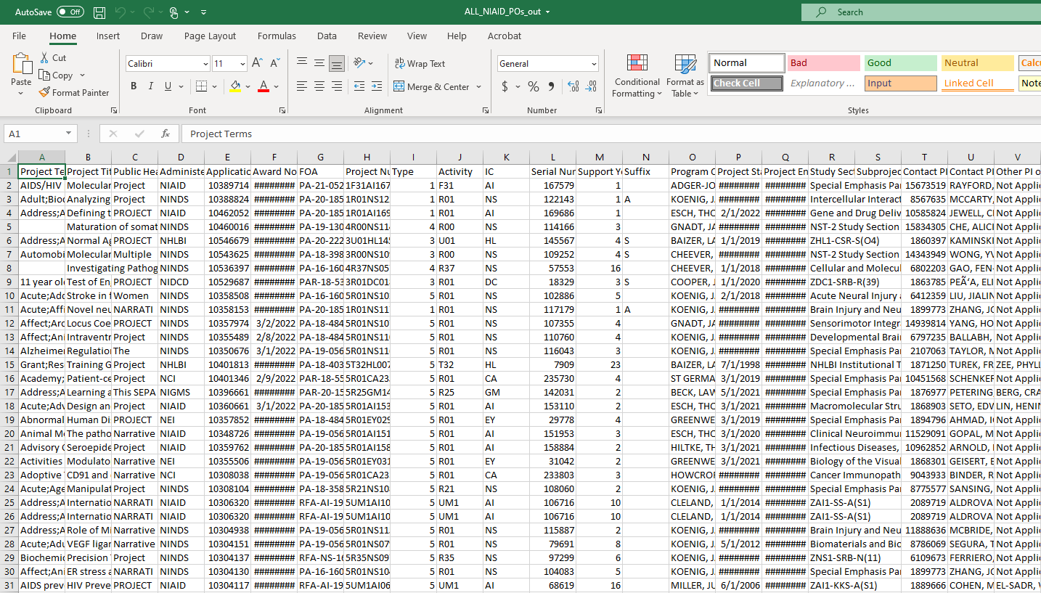
All Funded Applications NIAID Between 1977 -2022
This Workbook Represents 45 years of Grants and has 10,911 Rows
Notes:
Types of Data

Slide 4
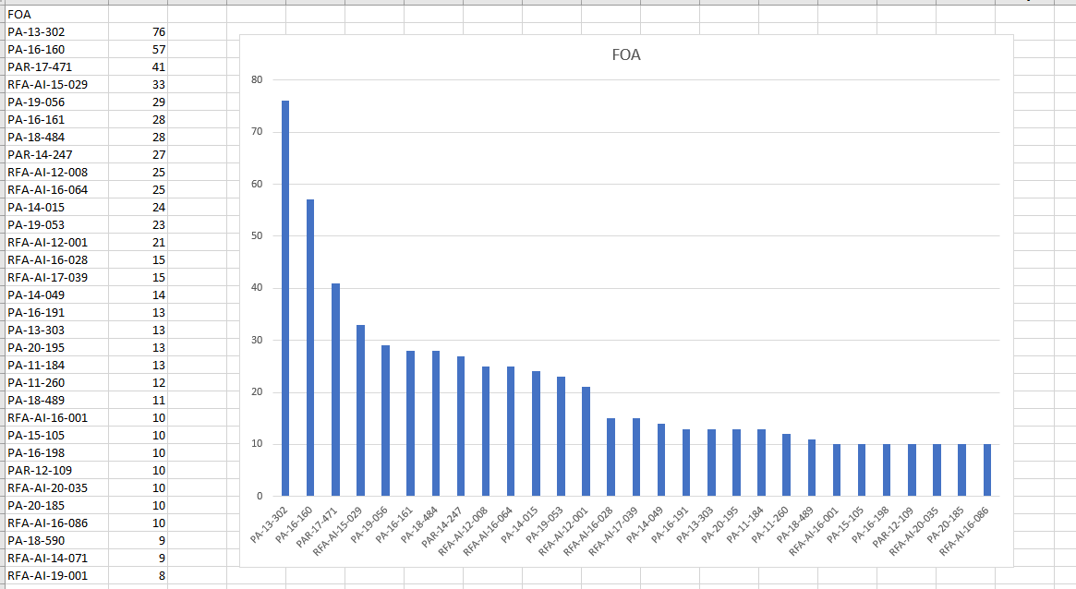
FOA Data
Notes:
FOA Data

Slide 5
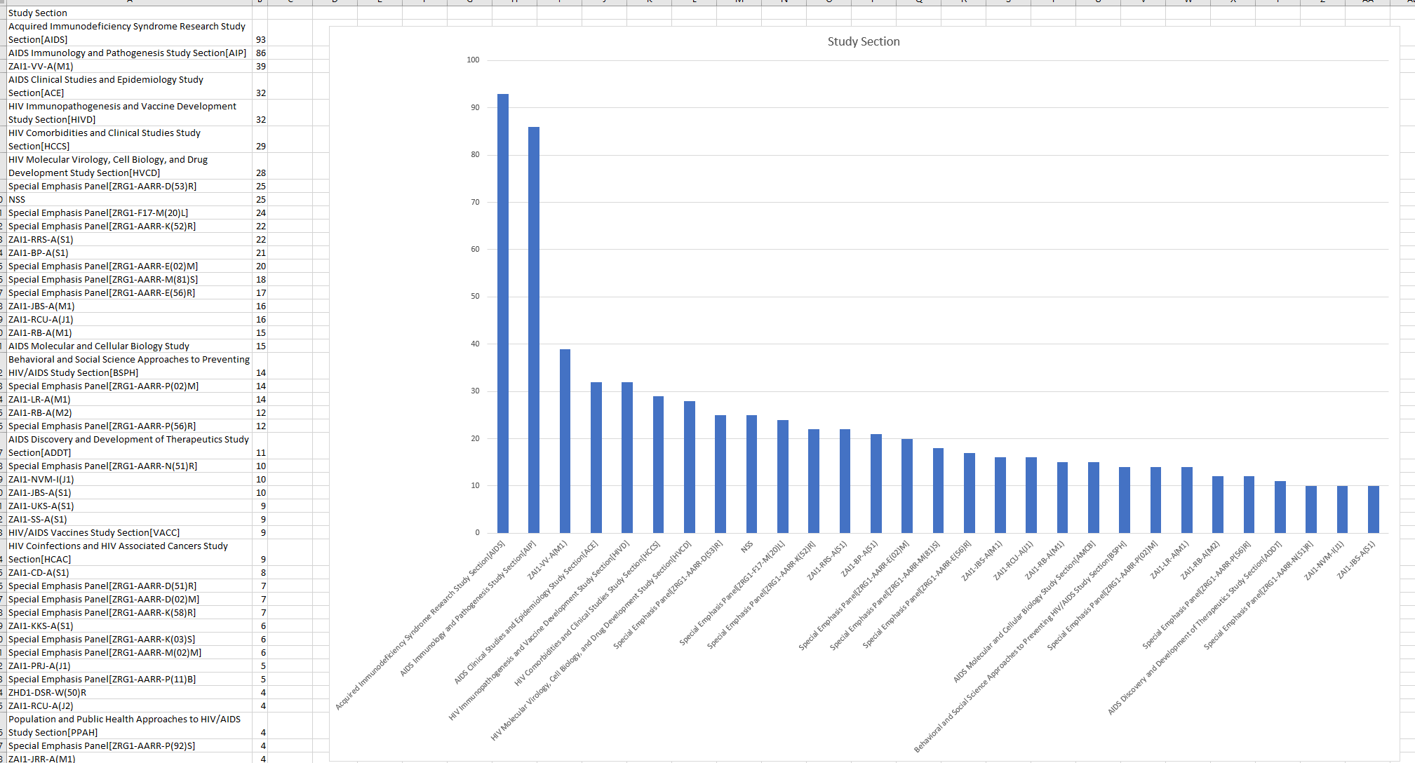
Study Section Data

Slide 6
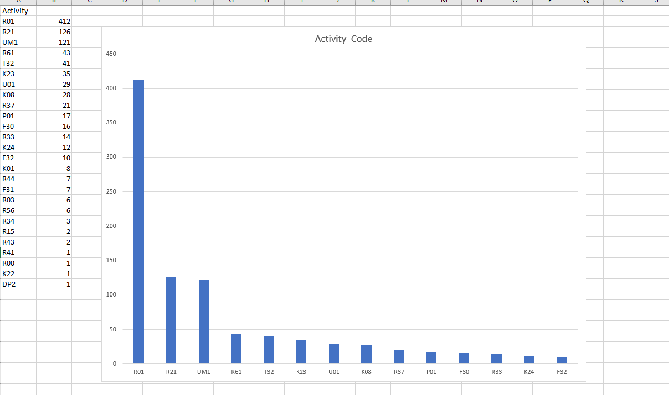
Activity Code Data

Slide 7
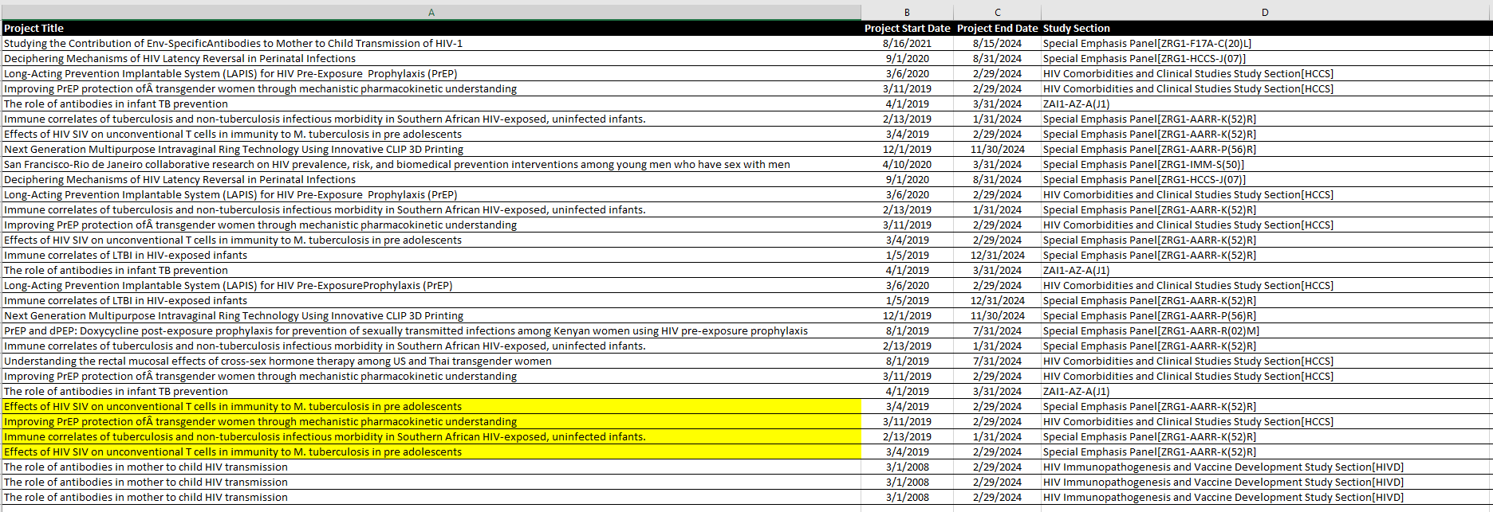
Projects ending in 2024 Data
NB: The highlighted rows are in their 4th year of funding

Slide 8
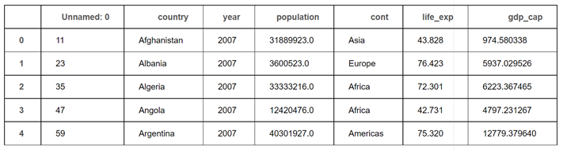
Structured Columnar Data from Between 1952 and 2007 for GNP, Population, Life Expectancy, for Various Countries with Developing Economies

Slide 9
Examples of Animated Data

Slide 10
What is so remarkable about the use of animation is that it allows for the graphical representation of a tremendous amount of data from a period of many years in a single slide

Slide 11
An animated balloon plot showing 55 years of data set to the years and decades between 1952 and 2007 Displays the rise in GNP in countries with developing economies and the effect on enfant mortality
Notes:
This ‘gif’ animation shows how 55 years of data (and PowerPoint slides) can be graphically represented in a one-minute animation which can be paused by simply clicking on it, which I find to be a powerful capability in helping one share and gain insight from Big Data and by doing so extract and share knowledge.

Slide 12
The End
Notes:
The End

Slide 13
Questions?
Notes:
Questions?

